Slide 1



JAL JEEVAN MISSION
NABARD CONSULTANCY SERVICES
PROGRESS REPORT
DISTRICT: NASHIK
NASHIK REGION
MARCH, 2023

Slide 2
District Work Status
Taluka | Category | No. of Schemes | Work Order Issued | Work In Progress | Work Not Started
Baglan | Retro | 16 | 16 | 16 | 0
 | New | 8 | 8 | 6 | 2
Chandvad | Retro | 8 | 8 | 3 | 5
 | New | 5 | 5 | 2 | 3
Deola | Retro | 2 | 2 | 0 | 2
 | New | 0 | 0 | 0 | 0
Dindori | Retro | 7 | 7 | 6 | 1
 | New | 0 | 0 | 0 | 0
Igatpuri | Retro | 16 | 16 | 16 | 0
 | New | 6 | 6 | 6 | 0
Kalwan | Retro | 13 | 13 | 9 | 4
 | New | 2 | 2 | 0 | 2
Nashik | Retro | 0 | 0 | 0 | 0
 | New | 9 | 9 | 8 | 1
Niphad | Retro | 1 | 1 | 1 | 0
 | New | 1 | 1 | 0 | 1

Slide 3
District Work Status
Taluka | Category | No. of Schemes | Work Order Issued | Work In Progress | Work Not Started
Peth | Retro | 0 | 0 | 0 | 0
 | New | 10 | 10 | 8 | 2
Sinnar | Retro | 10 | 10 | 6 | 4
 | New | 4 | 4 | 4 | 0
Surgana | Retro | 9 | 9 | 6 | 3
 | New | 13 | 13 | 8 | 5
Trimbakeshwar | Retro | 6 | 6 | 5 | 1
 | New | 10 | 10 | 7 | 3
Total | Retro | 86 | 86 | 68 | 18
 | New | 68 | 68 | 49 | 19
Grand Total |  | 154 | 154 | 117 | 37

Slide 4
Executive Summary Work in Progress Schemes
Taluka | Category | Total No. of Schemes | No. of Schemes based on Physical Progress %
 |  |  | < 25% | 25 < 50% | 50 < 75% | 75 < 100% | Commissioned
Baglan | Retro | 16 | 14 | 2 | 0 | 0 | 0
 | New | 6 | 6 | 0 | 0 | 0 | 0
Chandvad | Retro | 3 | 2 | 0 | 1 | 0 | 0
 | New | 2 | 0 | 1 | 1 | 0 | 0
Dindori | Retro | 6 | 2 | 2 | 2 | 0 | 0
 | New | 0 | 0 | 0 | 0 | 0 | 0
Igatpuri | Retro | 16 | 14 | 0 | 1 | 1 | 0
 | New | 6 | 6 | 0 | 0 | 0 | 0
Kalwan | Retro | 9 | 9 | 0 | 0 | 0 | 0
 | New | 0 | 0 | 0 | 0 | 0 | 0
Nashik | Retro | 0 | 0 | 0 | 0 | 0 | 0
 | New | 8 | 8 | 0 | 0 | 0 | 0
Niphad | Retro | 1 | 0 | 0 | 1 | 0 | 0
 | New | 0 | 0 | 0 | 0 | 0 | 0
Peth | Retro | 0 | 0 | 0 | 0 | 0 | 0
 | New | 8 | 7 | 0 | 1 | 0 | 0

Slide 5
Executive Summary Work in Progress Schemes
Taluka | Category | Total No. of Schemes | No. of Schemes based on Physical Progress %
 |  |  | < 25% | 25 < 50% | 50 < 75% | 75 < 100% | Commissioned
Sinnar | Retro | 6 | 6 | 0 | 0 | 0 | 0
 | New | 4 | 3 | 1 | 0 | 0 | 0
Surgana | Retro | 6 | 5 | 1 | 0 | 0 | 0
 | New | 8 | 8 | 0 | 0 | 0 | 0
Trimbakeshwar | Retro | 5 | 5 | 0 | 0 | 0 | 0
 | New | 7 | 5 | 2 | 0 | 0 | 0
Total | Retro | 68 | 57 | 5 | 5 | 1 | 0
 | New | 49 | 43 | 4 | 2 | 0 | 0
Grand Total |  | 117 | 100 | 9 | 7 | 1 | 0

Slide 6
Abstract of Schemes – Work in Progress Category – “Retro”
Sr No | Scheme Name | Name of Agency | W.O. Amount (excl GST) | W.O. Date | Construction Period | Physical Progress | RA Bill (Recommended) % | RA Bill (Recommended) In Lakhs
Baglan Taluka | Baglan Taluka
1 | Vathode | Kalyani Sachin Kapadnis | 1,78,64,419 | 28-10-2022 | 18 Months | 30.77% | 24.77% | 44.25
2 | Waghambe | Anirudh Avinash Kapadnis | 97,45,835 | 28-10-2022 | 18 Months | 48.24% | 47.22% | 46.02
3 | Morenagar | Abhijit Santosh Patil | 2,10,62,650 | 04-01-2023 | 17.26 Months | 20.00% | - | -
4 | Rahud | M.B Khatik | 1,95,14,730 | 26-12-2022 | 12 Months | 13.21% | - | -
5 | Thengode | Girish Milind Patil | 1,16,32,474 | 01-11-2022 | 17 Months | 9.70% | - | -
6 | Pathave | Dipak Chila Ahire | 1,72,59,374 | 28-10-2022 | 18 Months | 7.61% | - | -
7 | Vatar | Dawange And Chaudhary Associates | 74,51,174 | 03-01-2023 | 11 Months | 3.73% | - | -
8 | Kotbel | Sanjay Dadasahbeb Bhabad | 1,69,22,333 | 26-12-2022 | 12 Months | 2.98% | - | -
9 | Munjwad | M.B Khatik | 1,61,30,609 | 12-09-2022 | 18 Months | 0.92% | - | -
10 | Shripurvade | Deepak Chila Ahire | 87,50,789 | 27-09-2022 | 13.4 Months | 0.76% | - | -
11 | Maliwade | Atish Subash Patil | 1,33,58,584 | 08-09-2022 | 12 Months | 0.72% | - | -
12 | Thembekhalche | Dipak Chila Ahire | 91,57,043 | 03-11-2022 | 7 Months | 0.66% | - | -
13 | Tembhe Varche | Vinay Ashok Kuwar | 87,54,352 | 28-03-2022 | 18 Months | 0.57% | - | -

Slide 7
Abstract of Schemes – Work in Progress Category – “Retro”
Sr No | Scheme Name | Name of Agency | W.O. Amount (excl GST) | W.O. Date | Construction Period | Physical Progress | RA Bill (Recommended) % | RA Bill (Recommended) In Lakhs
14 | Mungse | Abhijeet Santosh Patil | 1,23,63,755 | 15-09-2022 | 12.15 Months | 0.48% | - | -
15 | Dayne | Dipak Chilla Ahire | 1,00,43,953 | 02-09-2022 | 11 Months | 0.15% | - | -
16 | Ajmir Saundane | Nitesh Mohan Maalwani | 1,71,85,328 | 20-12-2022 | 15.11 Months | 0.01% | - | -
Chandvad Taluka | Chandvad Taluka
17 | Kalkhode | Saushant Dattatrey Gade | 91,15,804 | 13-12-2022 | 12 Months | 79.41% | 78.73% | 71.77
18 | Kokankhede | Amol Rajendra Thakare | 87,37,248 | 12-01-2023 | 11 Months | 7.14% | - | -
19 | Jambutke | Keshav Tukaram Pawar | 40,08,267 | 29-11-2022 | 6 Months | 1.53% | - | -
Dindori Taluka | Dindori Taluka
20 | Deoghar | Shashikant Sanjay Lahane | 30,40,441 | 20-09-2022 | 8 Months | 72.96% | 71.09% | 21.61
21 | Savarpada | Kiran Bhaosaheb Mheisdhune | 28,85,855 | 06-09-2022 | 9 Months | 71.63% | 70.44% | 20.33
22 | Thepenpada | Kiran Bhausaheb Mheisdhune | 16,32,933 | 01-09-2022 | 6 Months | 41.71% | - | -
23 | Savarpathali | Akshay Shantaram Jadhav | 53,40,577 | 10-10-2022 | 12 Months | 32.99% | - | -
24 | Materewadi | Kiran Bhausaheb Mhasdune | 38,51,169 | 01-11-2022 | 7 Months | 2.71% | - | -
25 | Mokhnal | Umesh Gyandev Ugade | 93,42,207 | 01-11-2022 | 11 Months | 0.97% | - | -

Slide 8
Abstract of Schemes – Work in Progress Category – “Retro”
Sr No | Scheme Name | Name of Agency | W.O. Amount (excl GST) | W.O. Date | Construction Period | Physical Progress | RA Bill (Recommended) % | RA Bill (Recommended) In Lakhs
Igatpuri Taluka | Igatpuri Taluka
26 | Ninavi | Anil Ramchandra Kadalkar | 84,85,484 | 13-06-2022 | 12 Months | 77.71% | 60.84% | 51.63
27 | Bhavir Bk | Anil Ramchandra Kandarlar | 58,40,884 | 05-06-2022 | 9 Months | 50.04% | 43.91% | 25.65
28 | Kurunwadi | Rushikesh Anil Sahane | 1,04,90,163 | 11-09-2022 | 17 Months | 16.93% | - | -
29 | Nandgaon | Dawange And Chaudhary Associates | 25,48,245 | 25-08-2022 | 6 Months | 10.00% | - | -
30 | Gonde | Sopan Bhaskar Khade | 1,51,91,876 | 22-02-2022 | 15 Months | 9.97% | - | -
31 | Adsare Bk | Atish Subhash Patil | 1,60,96,688 | 09-11-2022 | 18 Months | 5.63% | - | -
32 | Bhavali Bk | Shukhkarta Kantubel, Pr. Pr. Shri Shrkhar Narayan Rao Ugle | 73,61,118 | 09-11-2022 | 11.22 Months | 5.27% | - | -
33 | Bambalewadi | Jitendra Balasaheb Zankar | 60,20,479 | 15-11-2022 | 11 Months | 4.46% | - | -
34 | Manwedhe | Baburao Eknath Gorve | 1,01,76,809 | 08-02-2022 | 17 Months | 4.38% | - | -
35 | Gambhirwadi | Santosh Shivaji Shinde | 47,94,452 | 12-01-2023 | 11 Months | 3.00% | - | -
36 | Dharnoli | Punjaram Kedu Kale | 45,97,558 | 21-04-2022 | 6 Months | 2.72% | - | -
37 | Nagosli | Praful Arunrao Bedse | 80,75,138 | 09-11-2022 | 11 Months | 2.00% | - | -
38 | Laxminagar | Sanjay Dadashaheb Bhabad | 1,21,17,464 | 02-08-2022 | 17 Months | 1.64% | - | -

Slide 9
Abstract of Schemes – Work in Progress Category – “Retro”
Sr No | Scheme Name | Name of Agency | W.O. Amount (excl GST) | W.O. Date | Construction Period | Physical Progress | RA Bill (Recommended) % | RA Bill (Recommended) In Lakhs
39 | Nadurvaidya | Dawange And Chaudary Associates | 63,66,490 | 25-08-2022 | 12 Months | 1.48% | - | -
40 | Avachitwadi | Shantaram Kishan Rakh | 54,51,864 | 20-10-2022 | 12 Months | 1.22% | - | -
41 | Borli |  | 1,12,52,541 | 01-11-2022 | 18 Months | 0.13% | - | -
Kalwan Taluka | Kalwan Taluka
42 | Verule | Vijay Balasaheb Patil | 37,77,578 | 20-10-2022 | 6 Months | 12.84% | - | -
43 | Mangalidar-Virshet | Vijaybalasaheb Patil | 58,95,401 | 14-10-2022 | 12 Months | 10.68% | - | -
44 | Dahyane Pale | Ashish Bhagwan Bhamre | 34,19,409 | 13-12-2022 | 6 Months | 4.33% | - | -
45 | Warkheda | Om Sai Electricals Services | 73,71,896 | 17-10-2022 | 11 Months | 4.10% | - | -
46 | Dahyane(O) | Sunil Baghad | 88,62,033 | 17-10-2022 | 11 Months | 1.59% | - | -
47 | Katharedigar | Vijay Balasaheb Patil | 42,35,644 | 14-10-2022 | 5 Months | 0.74% | - | -
48 | Shrugarwadi | Nitin Ashok Kakad | 38,65,777 | 01-12-2022 | 7 Months | 0.57% | - | -
49 | Kundane K | Radhakisan Raghunath Bodke | 47,29,887 | 29-12-2022 | 6 Months | 0.27% | - | -
50 | Dhekale | Vijay Balasaheb Patil | 58,42,244 | 01-11-2022 | 11 Months | 0.19% | - | -

Slide 10
Abstract of Schemes – Work in Progress Category – “Retro”
Sr No | Scheme Name | Name of Agency | W.O. Amount (excl GST) | W.O. Date | Construction Period | Physical Progress | RA Bill (Recommended) % | RA Bill (Recommended) In Lakhs
Niphad Taluka | Niphad Taluka
51 | Ramnagar | Aditya Suresh Pangarkar | 71,64,017 | 20-01-2023 | 11 Months | 53.97% | 46.14% | 33.05
Sinnar Taluka | Sinnar Taluka
52 | Jaygaon | Bandu Ashok Sangle | 93,76,220 | 10-10-2022 | 11 Months | 22.90% | 17.13% | 16.06
53 | Jayprakashnagar | Prathamesh Zagade | 66,32,635 | 11-09-2022 | 13 Months | 5.47% | - | -
54 | Sangavi | Yashwant Sambhaji Kandalkar | 88,72,016 | 13-06-2022 | 11 Months | 0.90% | - | -
55 | Shivajinagar(Dapur) | Shantaram Kisan Rakh | 71,65,644 | 14-10-2022 | 12 Months | 0.74% | - | -
56 | Sayale | Rahul Daghu Sangale | 1,78,50,928 | 02-02-2023 | 16 Months | 0.27% | - | -
57 | Belu | Shram Safalya Construction | 28,27,732 | 08-04-2022 | 6 Months | 0.18% | - | -
Surgana Taluka | Surgana Taluka
58 | Rakshasbhuvan | Samadhan Sanjay Karad | 51,22,825 | 13-12-2022 | 12 Months | 26.91% | 23.89% | 12.24
59 | Wangan | Yogesh Ramesh Pangarkar | 69,86,107 | 13-12-2022 | 12 Months | 20.14% | 19.45% | 13.59
60 | Dudhawal | Nilesh Dipak Suryavanshi | 49,96,700 | 15-11-2022 | 7 Months | 6.77% | - | -
61 | Zagadpada | Sagar Vasant Vinchu | 27,57,744 | 10-01-2023 | 5 Months | 3.25% | - | -
62 | Gopalpur & Deshmukh Pada | Nikhil Shantaram Jadhav | 56,00,616 | 12-01-2023 | 12 Months | 1.78% | - | -

Slide 11
Abstract of Schemes – Work in Progress Category – “Retro”
Sr No | Scheme Name | Name of Agency | W.O. Amount (excl GST) | W.O. Date | Construction Period | Physical Progress | RA Bill (Recommended) % | RA Bill (Recommended) In Lakhs
63 | Khokari | Shantaram Kisan Rakh | 1,60,81,507 | 10-01-2023 | 11 Months | 0.48% | - | -
Trimbakeshwar Taluka | Trimbakeshwar Taluka
64 | Pimplad Trimbak | Praful Arunrao Bedse | 50,75,002 | 09-12-2022 | 12 Months | 21.43% | - | -
65 | Alvand | Praphul Arin Rao Bedse | 85,11,976 | 29-12-2022 | 12 Months | 2.06% | - | -
66 | Pegalwadi | Meghraj Suresh Avhad | 92,67,820 | 09-11-2022 | 11 Months | 1.23% | - | -
67 | Talwade Trimbak | Praful Arunrao Bedse | 1,73,46,931 | 12-01-2023 | 18 Months | 0.59% | - | -
68 | Dapure | Rahul Pradip Singh Pardeshi | 57,65,725 | 22-12-2022 | 12 Months | 0.40% | - | -

Slide 12
Abstract of Schemes – Work in Progress Category – “New”
Sr No | Scheme Name | Name of Agency | W.O. Amount (excl GST) | W.O. Date | Construction Period | Physical Progress | RA Bill (Recommended) % | RA Bill (Recommended) In Lakhs
Baglan Taluka | Baglan Taluka
1 | Taharabad | M.B. Khatik | 3,40,49,909 | 30-08-2022 | 19.1 Months | 22.00% | 20.15% | 68.61
2 | Navegaon | Ishwar Sahebrao Gunjal | 51,15,730 | 10-01-2022 | 24 Months | 12.23% | - | -
3 | Akhatwade | Paresh Deore | 1,88,01,201 | 28-03-2022 | 18 Months | 4.39% | - | -
4 | Kakadgaon | Dipak Chilla Ahire | 60,99,674 | 19-05-2022 | 13 Months | 1.28% | - | -
5 | Lakhampur | Paresh Parshuram Deore | 4,30,14,057 | 02-09-2022 | 18.29 Months | 0.58% | - | -
6 | Antapur | Vinay Ashok Kuwar | 1,31,15,971 | 26-12-2022 | 12 Months | 0.11% | - | -
Chandvad Taluka | Chandvad Taluka
7 | Malsane | Somnath Karbhari Dige | 45,33,850 | 15-09-2022 | 6.5 Months | 59.80% | 31.60% | 14.33
8 | Bhopane | Nilesh Dipak Suryavanshi | 57,63,052 | 01-12-2022 | 12 Months | 47.15% | 44.91% | 25.88
Igatpuri Taluka | Igatpuri Taluka
9 | Shenwad | Snehkumar Sonawane | 99,50,155 | 21-03-2022 | 12 Months | 16.28% | - | -
10 | Kawanai | Kiran Jagath Katale | 91,39,498 | 22-07-2022 | 12 Months | 5.40% | - | -
11 | Taloshi | Shriram Engineers Deshmukh | 80,47,528 | 29-03-2022 | 12 Months | 4.10% | - | -

Slide 13
Abstract of Schemes – Work in Progress Category – “New”
Sr No | Scheme Name | Name of Agency | W.O. Amount (excl GST) | W.O. Date | Construction Period | Physical Progress | RA Bill (Recommended) % | RA Bill (Recommended) In Lakhs
12 | Khairgaon | Dawange &Chaudhary Associates | 1,25,34,332 | 10-11-2022 | 18 Months | 0.72% | - | -
13 | Talogh&1 Vadi | Fardin Yushuf Shaikh | 1,14,07,085 | 09-11-2022 | 18 Months | 0.22% | - | -
14 | Khambale | Akshay Shantaram Jadhav | 1,66,66,380 | 19-12-2022 | 18 Months | 0.09% | - | -
Nashik Taluka | Nashik Taluka
15 | Vadgaon | Shriram Prabhakar Kashmire | 1,66,41,206 | 10-10-2022 | 5 Months | 1.98% | - | -
16 | Dahegaon | Swapnil Bhausaheb Shinde | 90,41,170 | 21-04-2022 | 11 Months | 1.25% | - | -
17 | Gangavarhe | Swapnil Bhausaheb Shinde | 97,33,329 | 21-04-2022 | 11 Months | 0.88% | - | -
18 | Savargaon | Swapnil Bhausaheb Shinde | 64,30,520 | 08-04-2022 | 11 Months | 0.84% | - | -
19 | Nagalwadi | Swapnil Bhausaheb Shinde | 96,00,313 | 26-05-2022 | 12 Months | 0.50% | - | -
20 | Dari | Meghraj Suraj Avhad | 1,92,00,849 | 19-12-2022 | 3 Months | 0.15% | - | -
21 | Vinchur Gawali&Sultanpur | Dawange &Chaudhary Associates | 1,33,22,785 | 19-12-2022 | 15 Months | 0.11% | - | -
22 | Matori | Sanjay Vitthal Suryavanshi | 2,44,21,844 | 12-01-2023 | 18 Months | 0.06% | - | -
Peth Taluka | Peth Taluka
23 | Gavandh | Om Gurudev Construction | 80,15,531 | 13-12-2022 | 12 Months | 61.90% | 58.01% | 46.50

Slide 14
Abstract of Schemes – Work in Progress Category – “New”
Sr No | Scheme Name | Name of Agency | W.O. Amount (excl GST) | W.O. Date | Construction Period | Physical Progress | RA Bill (Recommended) % | RA Bill (Recommended) In Lakhs
24 | Ligawane | Pradip Bhaupatil Sable | 47,88,594 | 19-12-2022 | 6 Months | 16.21% | - | -
25 | Bhadarpada | Sagar Somnath Sonawane | 52,62,767 | 01-12-2022 | 12 Months | 10.00% | - | -
26 | Virmal(Pahuchi Bari) | Shantaram Kisan Rakh | 46,38,577 | 20-09-2022 | 6 Months | 6.69% | - | -
27 | Pimpalpada & Mendhpada | Yashnarendra Deshmukh | 58,89,656 | 01-02-2023 | 12 Months | 6.68% | - | -
28 | Junoti | Nikhil Rajendra Deshmukh | 71,29,267 | 12-09-2022 | 12 Months | 4.58% | - | -
29 | Bhaygaon | Bhushan Gyaneshwar Chakor | 1,05,60,902 | 06-09-2022 | 17 Months | 3.16% | - | -
30 | Ruipetha | Nitin Ravindra Pagare | 1,28,24,138 | 12-01-2023 | 6 Months | 2.62% | - | -
Sinnar Taluka | Sinnar Taluka
31 | Nirhale | Atish Subhash Patil | 1,27,02,968 | 02-01-2023 | 17 Months | 49.12% | 34.55% | 43.89
32 | Borkhind | Suvarna Sanchit Shelke | 56,42,010 | 29-11-2022 | 12 Months | 11.65% | - | -
33 | Shivde | Kiran Jagannath Katale | 2,49,33,046 | 14-10-2022 | 12 Months | 6.46% | - | -
34 | Sawatamali | Shantaram Kisan Rakh | 83,78,889 | 02-01-2023 | 12 Months | 0.01% | - | -
Surgana Taluka | Surgana Taluka
35 | Karanjul | Nikhil Keshav Mahale | 47,59,141 | 10-01-2023 | 5 Months | 6.13% | - | -

Slide 15
Abstract of Schemes – Work in Progress Category – “New”
Sr No | Scheme Name | Name of Agency | W.O. Amount (excl GST) | W.O. Date | Construction Period | Physical Progress | RA Bill (Recommended) % | RA Bill (Recommended) In Lakhs
36 | Galbari | Shriram Prabhakar Kashmire | 58,19,779 | 06-12-2022 | 11 Months | 5.91% | - | -
37 | Ambabarhe(Gp Bhavada) | Yogeshwar Ramesh Pangarkar | 63,27,249 | 25-01-2023 | 11 Months | 3.72% | - | -
38 | Hanumantmal | Sagar Govind Vidhate | 83,61,114 | 13-12-2022 | 13 Months | 0.99% | - | -
39 | Patali | Pranav Sanjay Baviskar | 42,27,255 | 14-02-2023 | 11 Months | 0.89% | - | -
40 | Kahandolsa | Riyaz Kmaruddin Shaikh | 63,68,693 | 13-12-2022 | 12 Months | 0.78% | - | -
41 | Chinchpada | Devandra Jagannath Deore | 97,04,015 | 01-11-2022 | 9 Months | 0.35% | - | -
42 | Ambupada | Kiran Bhausaheb Mhaisdune | 44,01,520 | 11-09-2022 | 8 Months | 0.35% | - | -
Trimbakeshwar | Trimbakeshwar
43 | Deogaon | Shriram Prabhakar Kashmire | 1,72,38,879 | 28-06-2022 | 12 Months | 53.07% | 52.57% | 90.62
44 | Take Deogaon | Sanjay Dadasaheb Bhabhad | 1,07,83,574 | 31-03-2022 | 18 Months | 40.42% | 40.05% | 43.19
45 | Bhilmal&Pade | Nitin Ravindra Pagare | 98,97,340 | 12-09-2022 | 11 Months | 15.74% | - | -
46 | Kojuli | Anil Kale | 52,96,317 | 09-11-2022 | 11 Months | 6.07% | - | -
47 | Kotambi&3Pade | Yogesh Ramesh Pangarkar | 60,44,141 | 20-12-2022 | 12 Months | 0.76% | - | -
48 | Mulegaon | Shriram Prabhakar Kashmire | 2,99,54,753 | 12-01-2023 | 17 Months | 0.57% | - | -
49 | Murumbi & Wadi | Atish Subhash Patil | 1,46,61,286 | 02-01-2023 | 17 Months | 0.19% | - | -

Slide 16
DASHBOARD

Slide 17
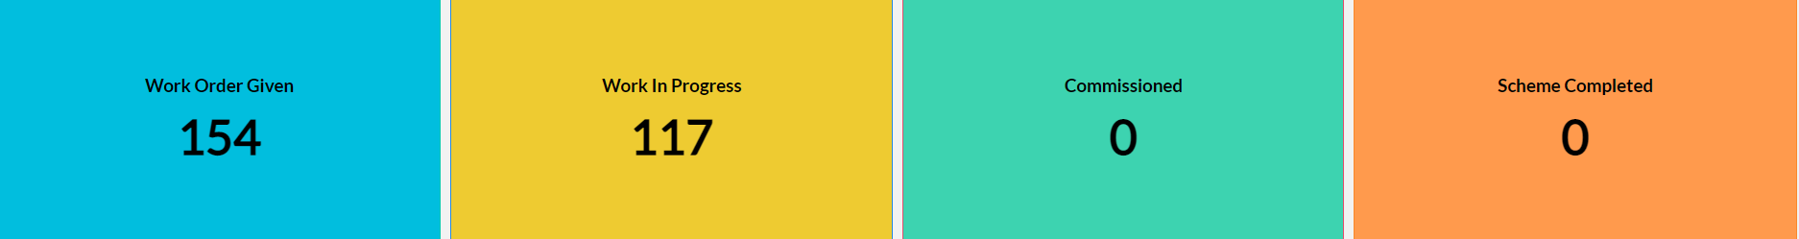
Dashboard
Work Status

Slide 18
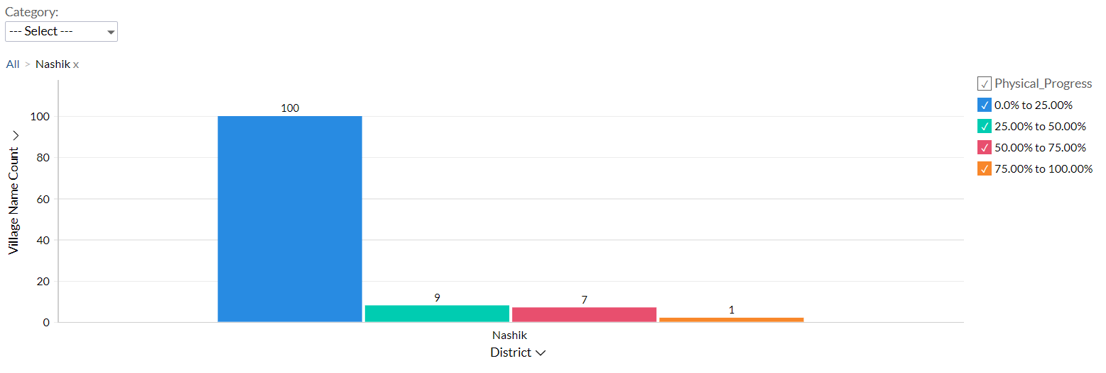
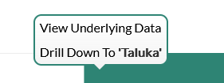
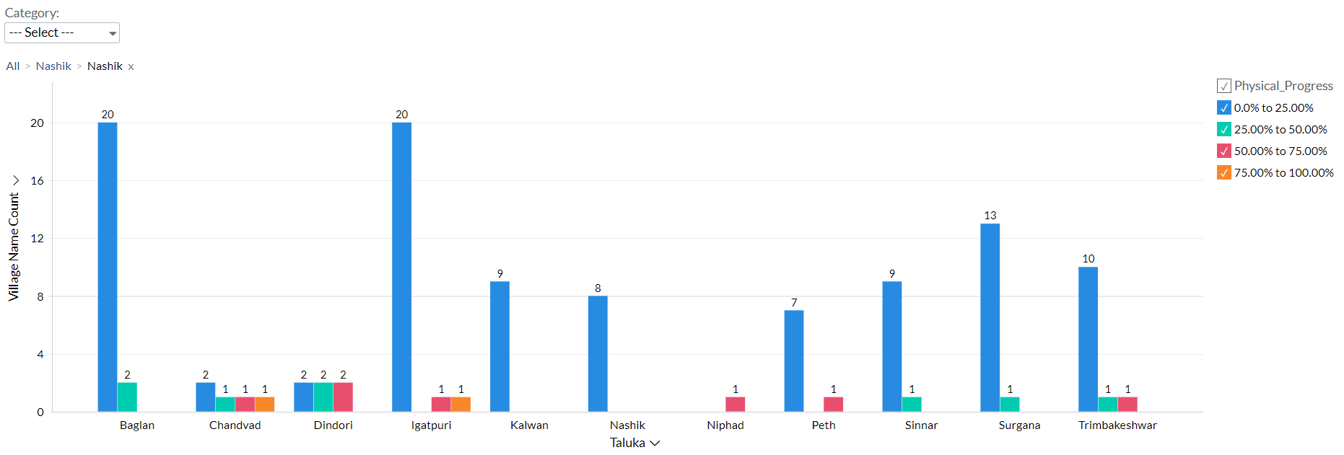
Dashboard
Progress Milestone
2
2

Slide 19
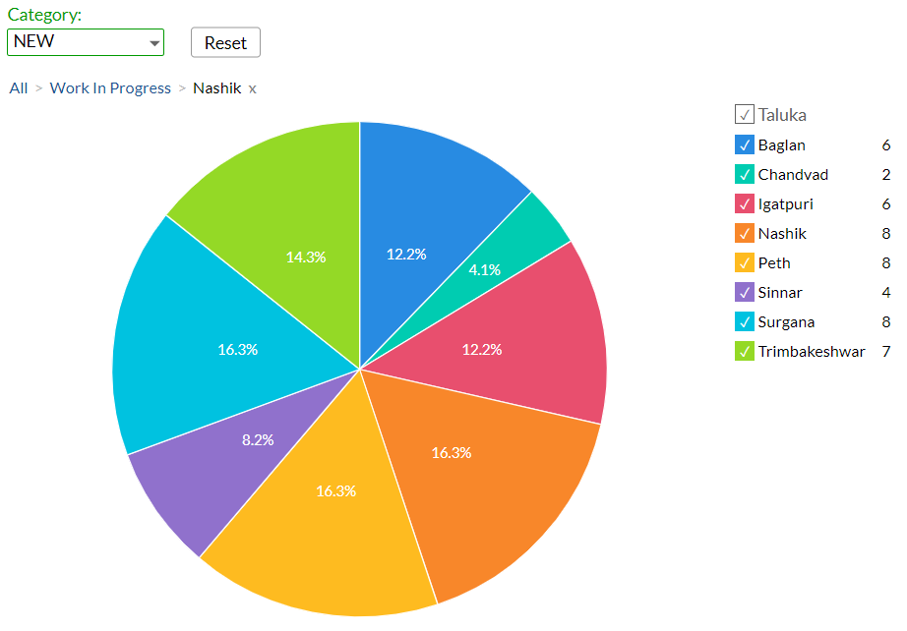
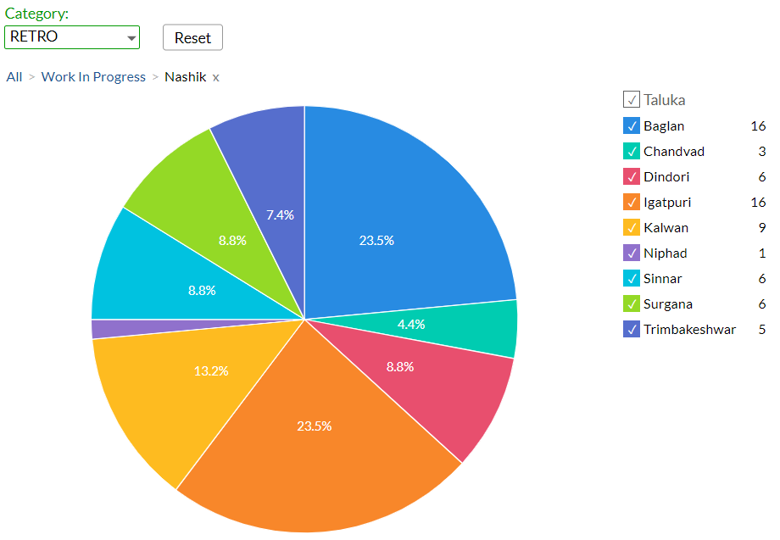
Dashboard
Work Status: “New Schemes”
Work Status: “Retro Schemes”

Slide 20
MS – PROJECT
Work in Progress Schemes

Slide 21
Project Overview Physical Progress vs Financial Progress vs Time Overrun

Slide 22
Late Schemes

Slide 23
SAMPLE SITE VISIT PHOTOS

Slide 24
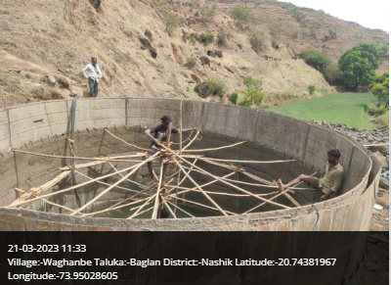
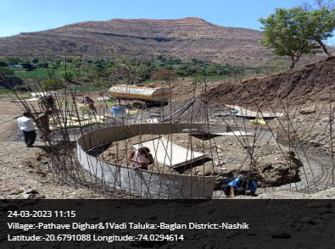
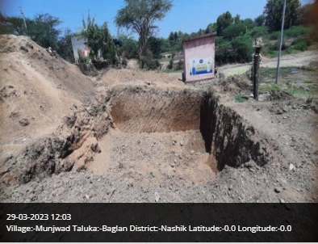
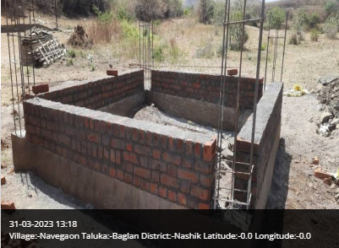
Baglan Taluka

Slide 25
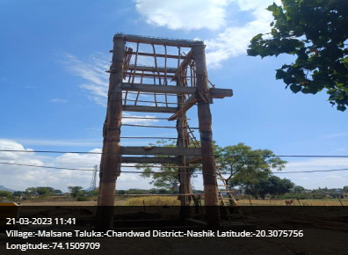
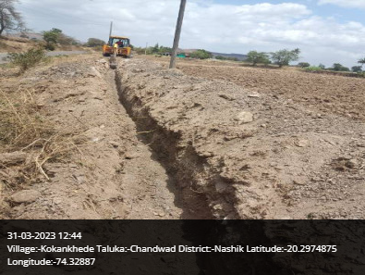
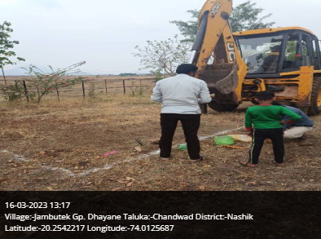
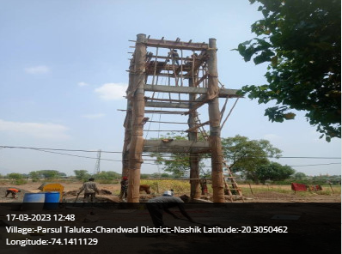
Chandvad Taluka

Slide 26
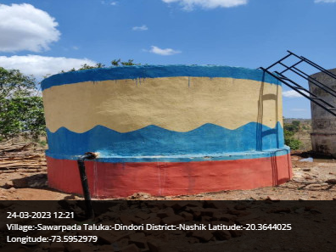
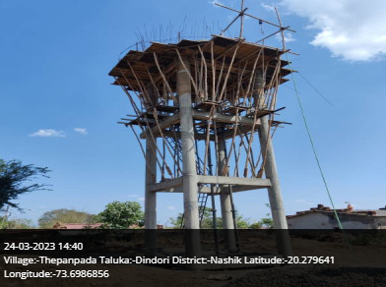
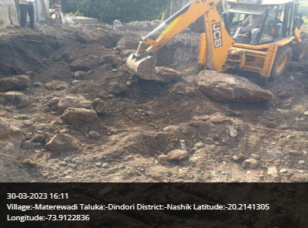
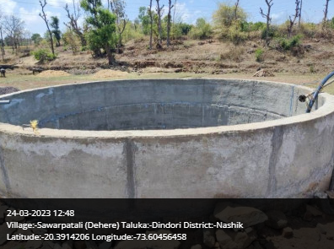
Dindori Taluka

Slide 27
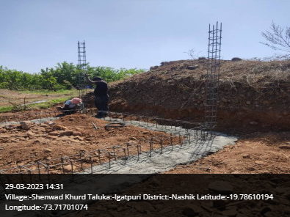
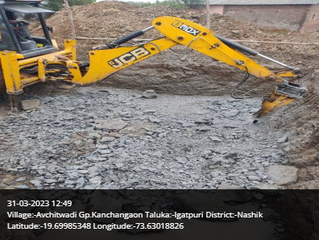
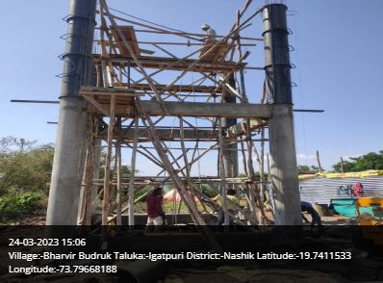
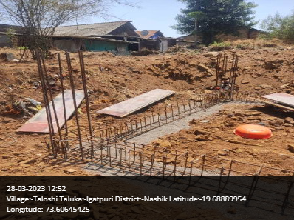
Igatpuri Taluka

Slide 28
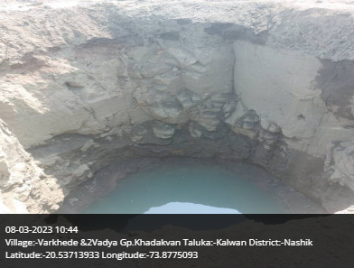
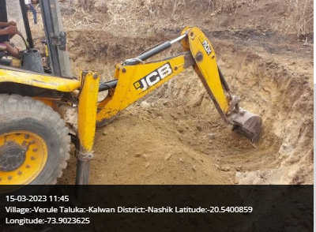
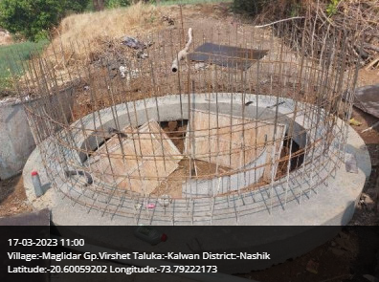
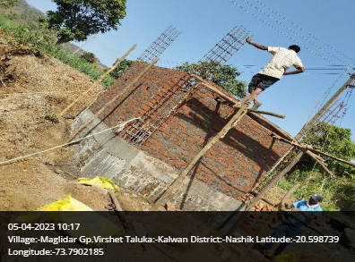
Kalwan Taluka

Slide 29
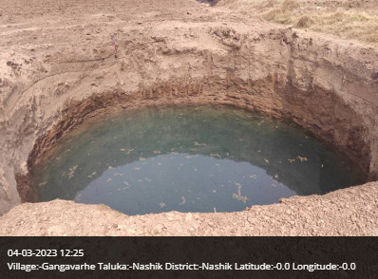
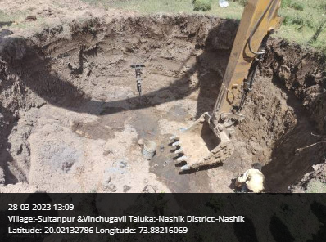
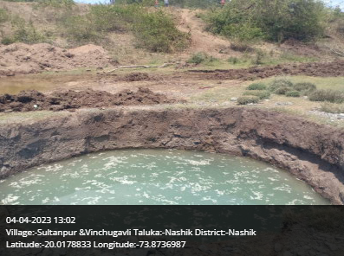
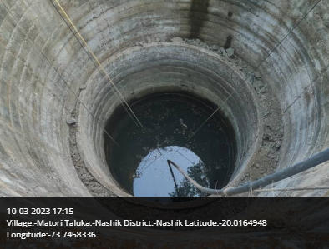
Nashik Taluka

Slide 30
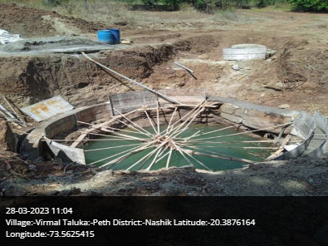
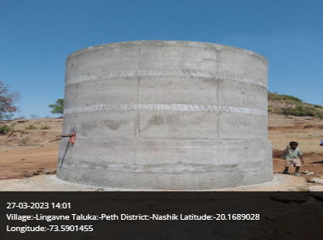
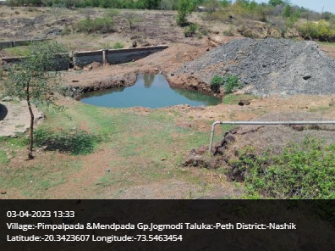
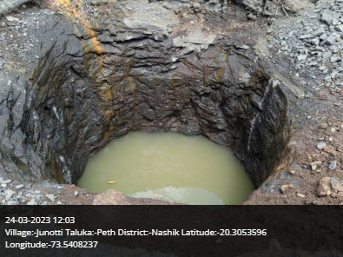
Peth Taluka

Slide 31
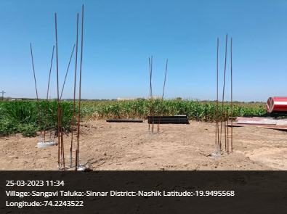
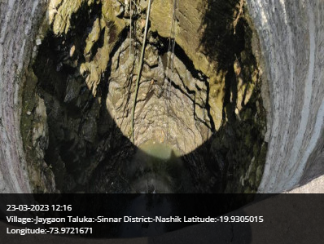
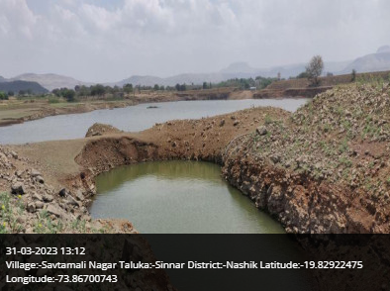
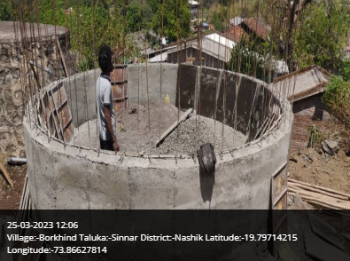
Sinnar Taluka

Slide 32
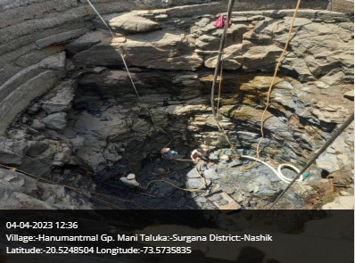
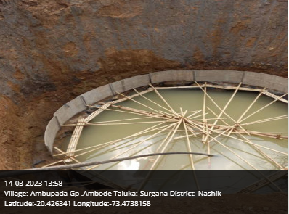
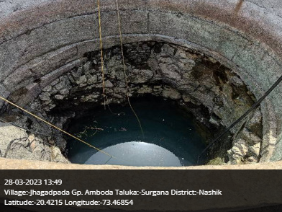
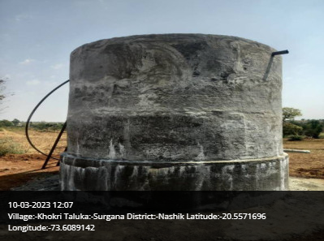
SurganaTaluka

Slide 33
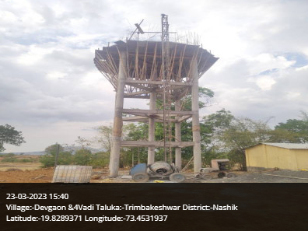
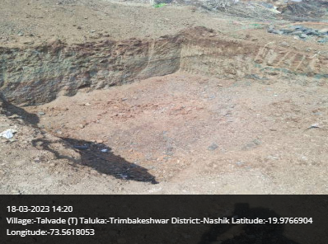
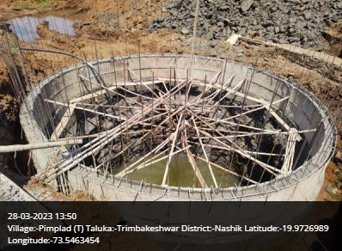
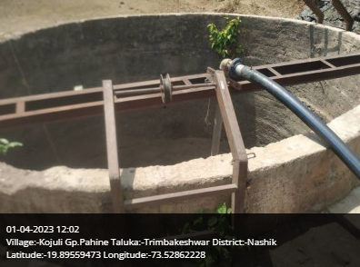
Sinnar Talukas

Slide 34

Thank You!

